Slide 1
Guest Lecture Memories and Register Transfer Logic
Dr. S. Shoba
Assistant Professor Sr. Gr. 2
VIT University, Chennai

Slide 2
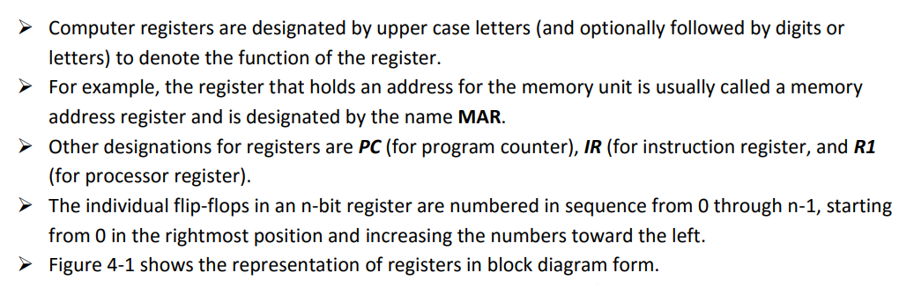
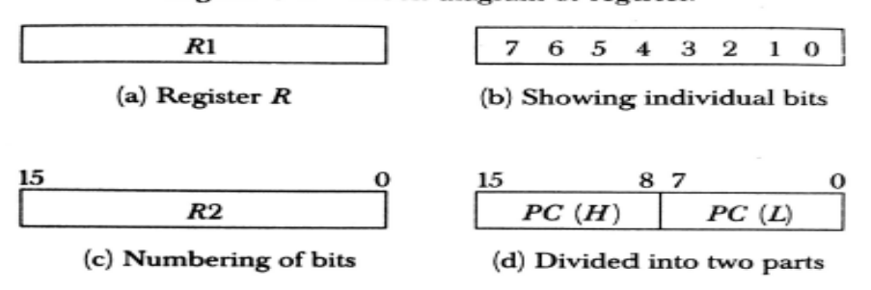
Register

Slide 3
Register Transfer operation
Register Transfer refers to the availability of hardware logic circuits that can perform a given micro-operation and transfer the result of the operation to the same or another register
Information transfer from one register to another is designated in symbolic form by means of a replacement operator.
The statement R2← R1 denotes a transfer of the content of register R1 into register R2.
It designates a replacement of the content of R2 by the content of R1.
Control unit P: R2← R1

Slide 4
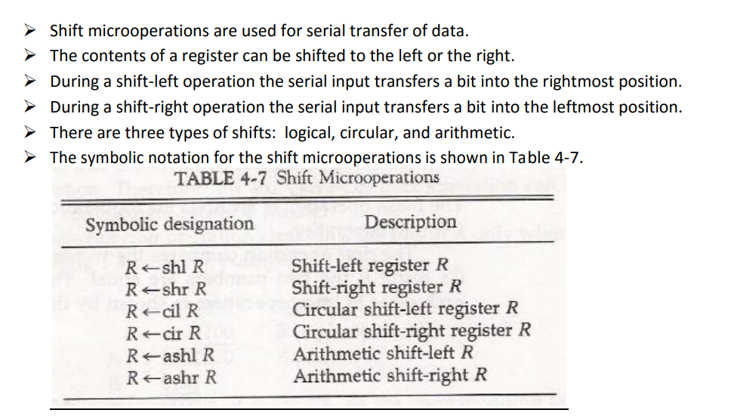
SHIFT MICRO OPERATION The operations executed on data stored in registers are called microoperations.

Slide 5
LOGICAL SHIFT
A logical shift is one that transfers 0 through the serial input.
The symbols shl and shr for logical shift-left and shift-right microoperations.
The microoperations that specify a 1-bit shift to the left of the content of register R and a 1-bit shift to the right of the content of register R
The bit transferred to the end position through the serial input is assumed to be 0 during a logical shift.

Slide 6
CIRCULAR SHIFT:
The circular shift (also known as a rotate operation) circulates the bits of the register around the two ends without loss of information.
This is accomplished by connecting the serial output of the shift register to its serial input.
We will use the symbols cil and cir for the circular shift left and right, respectively.

Slide 7
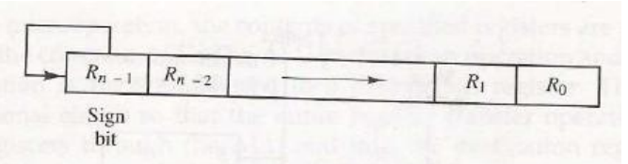
Arithmetic Shift:
An arithmetic shift is a microoperation that shifts a signed binary number to the left or right.
An arithmetic shift-left multiplies a signed binary number by 2.
An arithmetic shift-right divides the number by 2.
Arithmetic shifts must leave the sign bit unchanged because the sign of the number remains the same when it is multiplied or divided by 2.

Slide 8
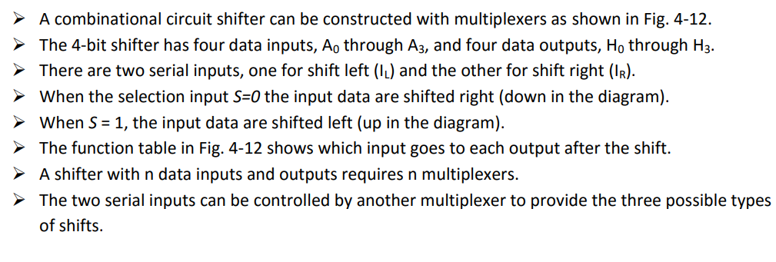
HARDWARE IMPLEMENTATION

Slide 9
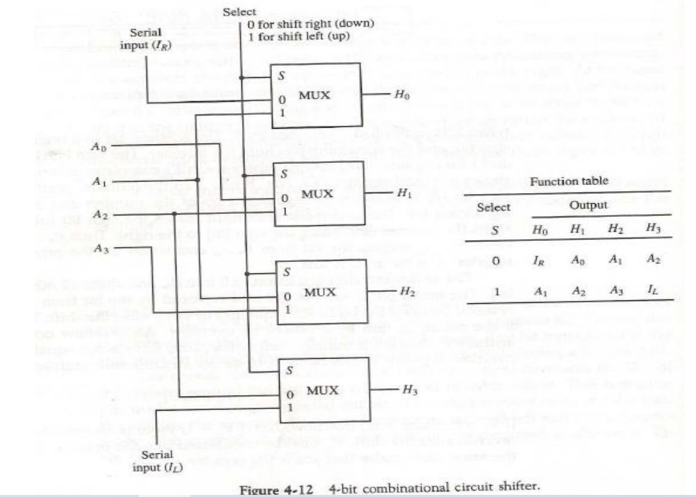

Slide 10
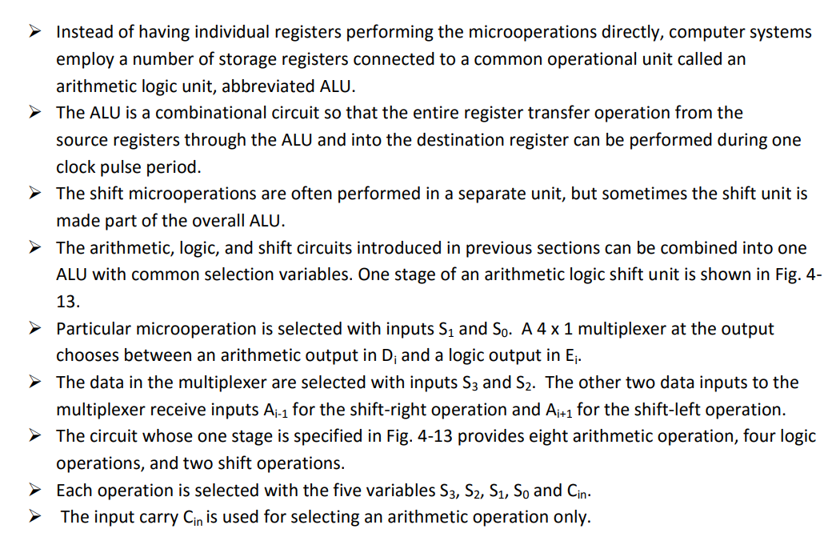
Arithmetic Logic Shift Unit:

Slide 11
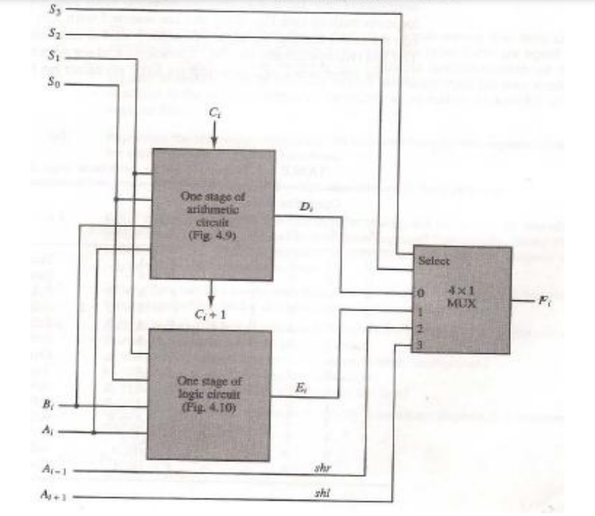

Slide 12
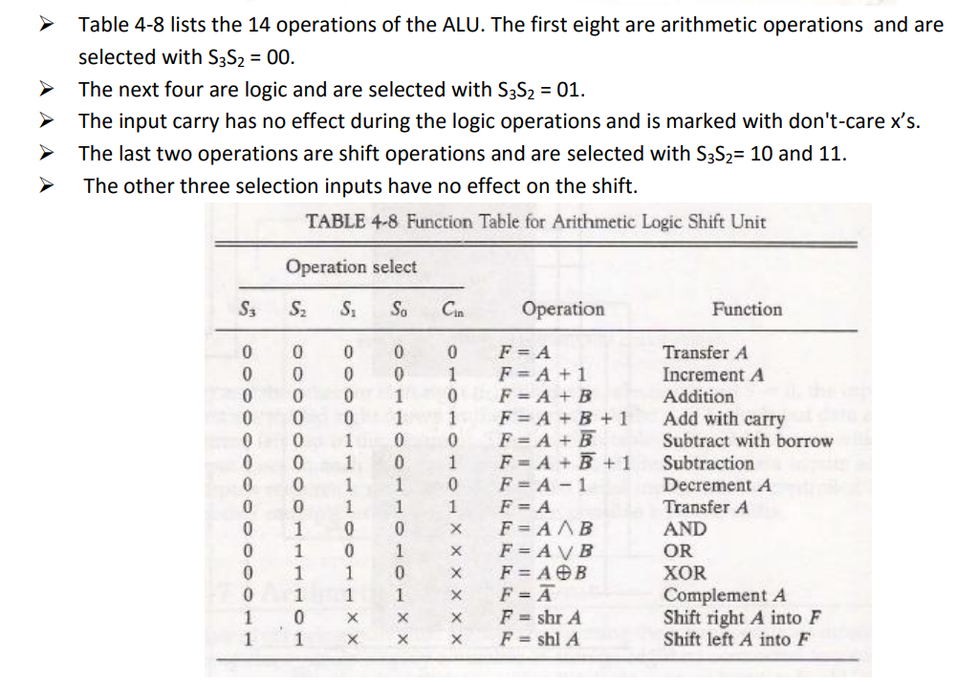

Slide 13
Conditional Control Statements
Specify a control condition by a conditional statement rather than a boolean control function
Symbolised by if-then-else statement
P : If(condition) then [microoperation(s)] else [microoperation(s)]
mean that if control condition stated within the parentheses after the word if is true, then microoperation enclosed within the parentheses after the word then is executed otherwise the microoperation listed within after the word else is executed
In any case the control function P must occur for anything to be done
If else part of the statement is missing then nothing is executed if the condition is not true

Slide 14
Conditional Control Statements
Eg:-
T2 : If (C=0) then (F ← 1) else (F ← 0)
F is asssumed to be 1-bit register(flip flop) that can be set or cleared.
If register C is a 1-bit register the statement is equivalent to the following statements
C’T2 : F ← 1
CT2 : F ← 0
Same timing variable can occur in two separate control function. The valu of C is 0 or 1. So only one microoperation will be executed during T2 depending on the value of C.
If C has more than 1 bit the condition C = 0 means that all bits of C must be 0.
Register C has 4 bits C1, C2, C3 and C4 the condition C=0 can be expressed with boolean function

Slide 15
Conditional Control Statements
x = C ‘₁C ‘₂C ‘₃C ‘₄ = (C₁ + C₂ + C₃ + C₄)’ variable x can be generated with a NOR gate.
Conditional control statements now equivalent to 2 statements
xT2 : F ← 1
x ‘T2 : F ← 0
variable x = 1 if C = 0 but is equal to 0 if C ₆= 0

Slide 16
Decimal Fixed-Point Representation
The representation of decimal numbers in registers is a function of the binary code used to represent a decimal digit
The representation of 4385 in BCD requires 16 flip-flops, four flip-flops for each digit
number of bits needed to store a decimal number in a binary code is greater than the number of bits needed for its equivalent binary representation
the circuits required to perform decimal arithmetic are more complex
0100 0011 1000 0101

Slide 17
Decimal Fixed-Point Representation
some computers and all electronic calculators perform arithmetic operations directly with the decimal data (in a binary code) and thus eliminate the need for conversion into binary and back to decimal.
Some computer systems have hardware for arithmetic calculations with both binary and decimal data
The representation of signed decimal numbers in BCD is similar to the representation of signed numbers in binary

Slide 18
Arithmetic Addition
The sign of a decimal number is usually represented with four bits to conform to the 4-bit code of the decimal digits. It is customary to designate a plus with four 0‘s and a minus with the BCD equivalent of 9, which is 1001
Consider the addition (+375) + (-240) = +135 done in the signed-10‘s complement system.
0 375 (0000 0011 0111 0101)BCD
+9 760 (1001 0111 0110 0000)BCD
10’s complement of 240
0 135 (0000 0001 0011 0101)BCD

Slide 19
Floating point Representation https://www.youtube.com/watch?v=NTwX21R8UE8
The floating-point representation of a number has two parts. The first part represents a signed, fixedpoint number called the mantissa(m). The second part designates the position of the decimal (or binary) point and is called the exponent (e), radix ®
For example, the decimal number +6132.789 is represented in floating-point with a fraction and an exponent as follows:
This representation is equivalent to the scientific notation +0.6132789 x 10⁺⁴.
Floating-point is always interpreted to represent a number in the following form:
m x r^{e}
Fraction Exponent
+0.6132789 +04

Slide 20

Floating point binary representation
A floating-point binary number is represented in a similar manner except that it uses base 2 for the exponent. For example, the binary number +1001.11 is represented with an 8-bit fraction and 6- bit exponent as follows:
The fraction has a 0 in the leftmost position to denote positive. The binary point of the fraction follows the sign bit but is not shown in the register. The exponent has the equivalent binary number +4. The floatingpoint number is equivalent to
m x 2e = +(.1001110)² x 2⁺⁴

Slide 21
Instruction Codes
Instruction codes are concise bit groups directing computers to execute specific operations efficiently. Instruction codes and addresses are unique to each computer.
Instruction codes are bits that instruct the computer to execute a specific operation. An instruction comprises groups called fields. These fields include:
The Operation code (Opcode) field determines the process that needs to perform.
The Address field contains the operand's location, i.e., register or memory location.
The Mode field specifies how the operand locates.

Slide 22
Structure of an Instruction Code
Opcode: The opcode (Operation code) represents the operation that the processor must perform. such as addition, subtraction, multiplication, or division.
Operand(s): The operand(s) represents the data that the operation must be performed on. This data can take various forms, depending on the processor's architecture. It might be a register containing a value, a memory address pointing to a location in memory where the data is stored, or a constant value embedded within the instruction itself.
Addressing mode: The addressing mode represents how the operand(s) can be interpreted. It might indicate that the operand is a direct address in memory, an indirect address (i.e. a memory address stored in a register), or an immediate value (i.e. a constant embedded within the instruction)

Slide 23
Types of Instruction Code
One-operand instructions: These instructions have one operand and perform an operation on that operand. For example, the "neg" instruction in the x86 assembly language negates the value of a single operand.
Two-operand instructions: These instructions have two operands and perform an operation involving both. For example, the "add" instruction in x86 assembly language adds two operands together.
Three-operand instructions: These instructions have three operands and perform an operation that involves all three operands. For example, the "fma" (fused multiply-add) instruction in some processors multiplies two operands together, adds a third operand, and stores the result in a fourth operand.

Slide 24
Types of Instruction Code
Data transfer instructions: These instructions move data between memory and registers or between registers. For example, the "mov" instruction in the x86 assembly language moves data from one location to another.
Control transfer instructions: These instructions change the flow of program execution by modifying the program counter. For example, the "jmp" instruction in the x86 assembly language jumps to a different location in the program.
Arithmetic instructions: These instructions perform mathematical operations on operands. For example, the "add" instruction in x86 assembly language adds two operands together.

Slide 25
Types of Instruction Code
Logical instructions: These instructions perform logical operations on operands. For example, the "and" instruction in x86 assembly language performs a bitwise AND operation on two operands.
Comparison instructions: These instructions compare two operands and set a flag based on the result. For example, the "cmp" instruction in x86 assembly language compares two operands and sets a flag indicating whether they are equal, greater than, or less than.
Floating-point instructions: These instructions perform arithmetic and other operations on floating-point numbers. For example, the "fadd" instruction in the x86 assembly language adds two floating-point numbers together.

Slide 26
Opcodes
There are three different types of instruction codes on the main computer.
The instruction's operation code (opcode) is 3 bits long, and the remaining 13 bits are determined by the operation code encountered.
There are three types of formats:
Memory Reference Instruction: It specifies the address with 12 bits and the addressing mode with 1 bit (I). For direct addresses, I equal 0, while for indirect addresses, I equal 1.
Register Reference Instruction: The opcode 111 with a 0 in the leftmost bit of the instruction recognizes these instructions. The remaining 12 bits specify the procedure to be carried out.
Input-Output Instruction: The operation code 111 with a 1 in the leftmost bit of instruction recognizes these instructions. The input-output action is specified using the remaining 12 bits.

Slide 27
Address
Direct Addressing − Uses the address of the operand. “MOV AX, BX”
Indirect Addressing − Enables the address as a pointer to the operand. “MOV AX, [BX]”
Immediate operand − The second part of the instruction code specifies an operand. MVI B 45
Accumulator Register (AC): This register is found in single register processors (AC), and it performs all operations with memory operands.
Effective Address (EA) is the address of the operand or the target address. It defines the address that we can execute as a target address for a branch-type instruction or the address we can use directly to create an operand for a computation-type instruction without any changes.

Slide 28
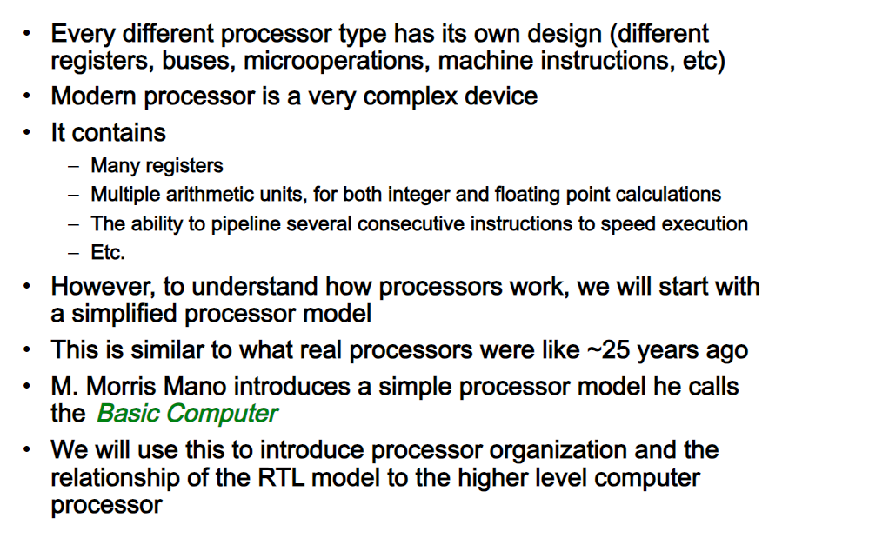
DESIGN OF BASIC COMPUTER

Slide 29
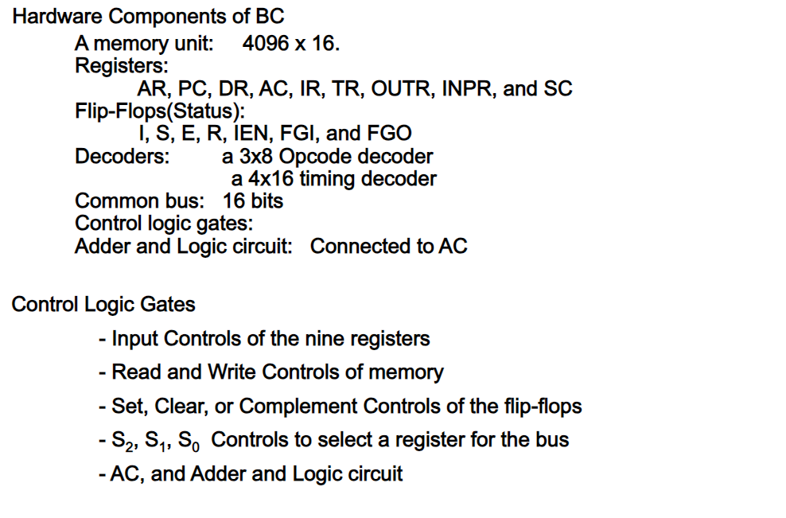
COMPONENTS

Slide 30
ABBREVIATION
TR – Temporary register
INPR – Input register
SC- sequence counter
FGI – flag flip flop
AC- Accumulator logic
MAR – Memory address register

Slide 31
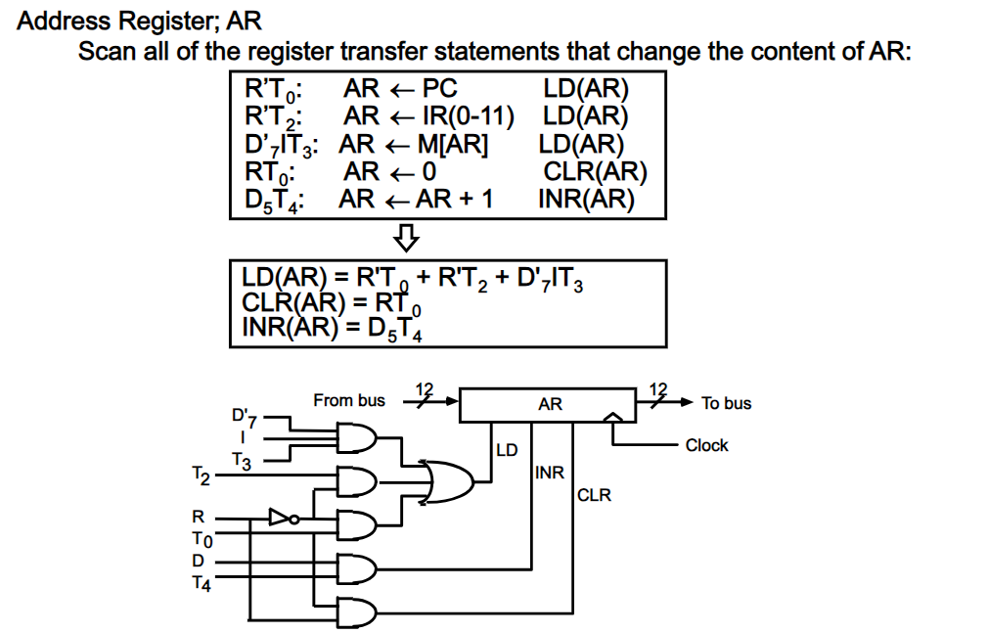
CONTROL OF REGISTER

Slide 32
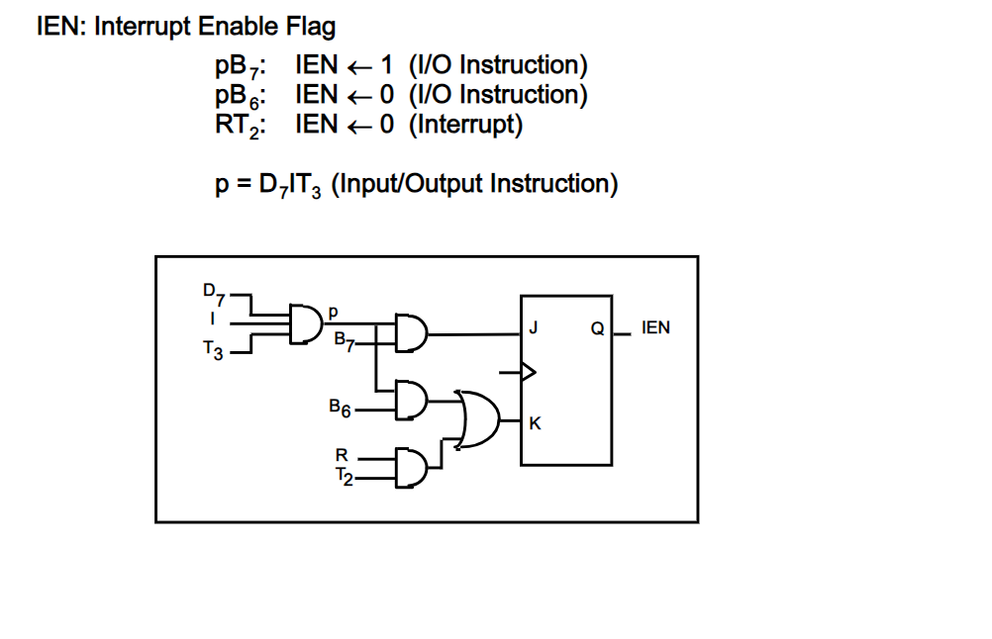
CONTROL OF FLAGS

Slide 33
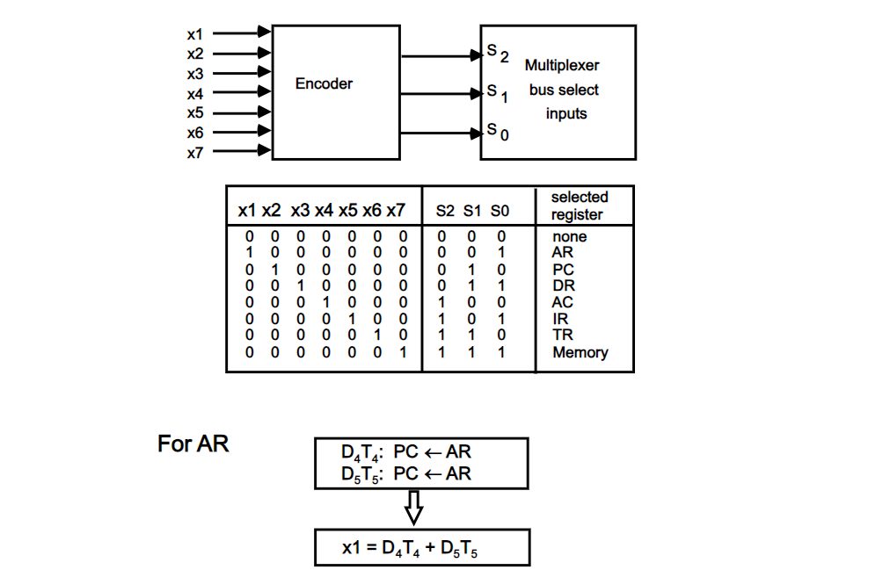
CONTROL OF COMMON BUS

Slide 34
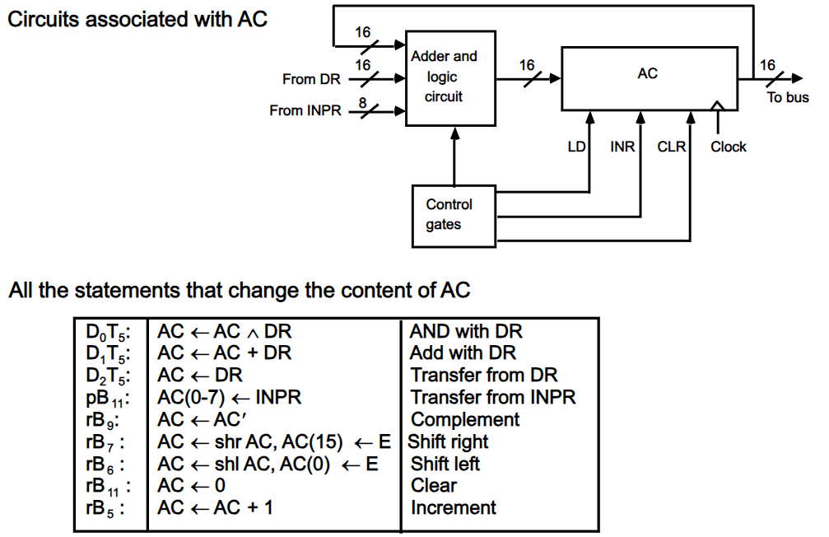
DESIGN OF ACCUMULATOR LOGIC

Slide 35
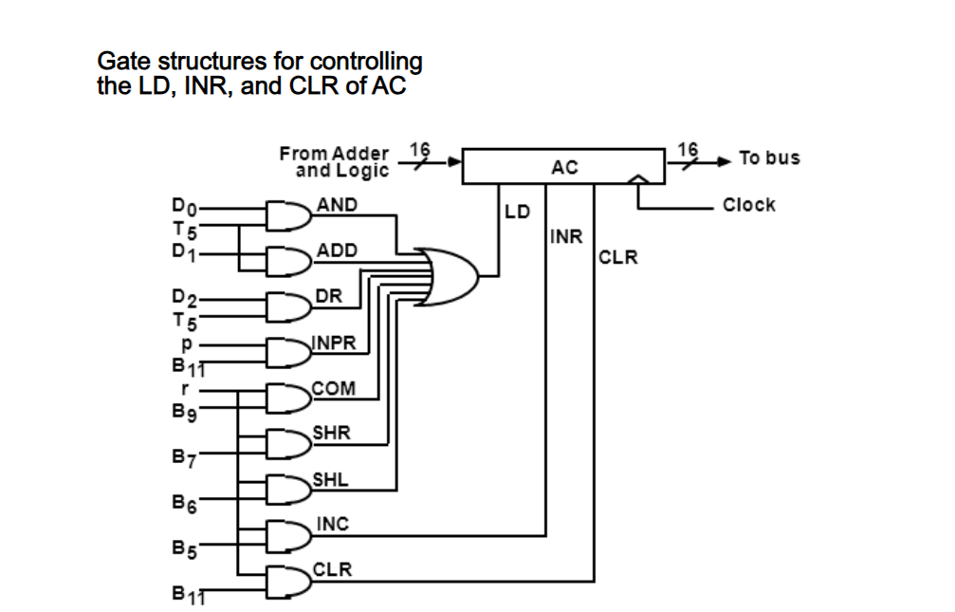
CONTROL OF AC REGISTER

Slide 36
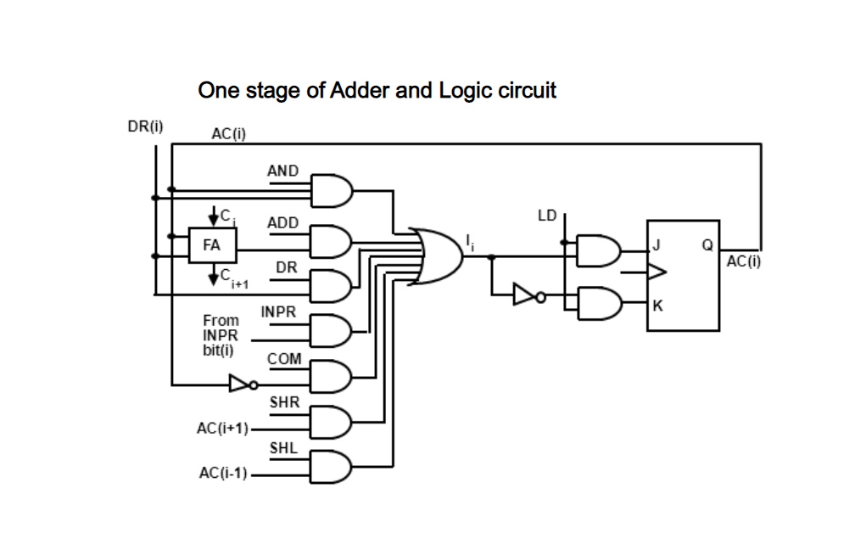
ALU (ADDER AND LOGIC UNIT)

Slide 37
Thank you

